Slide 1
Dr. Yifeng Zhu Electrical and Computer Engineering University of Maine
Embedded Systems with ARM Cortex-M Microcontrollers in Assembly Language and C
Chapter 1
Computer and Assembly Language
Spring 2020

Slide 2
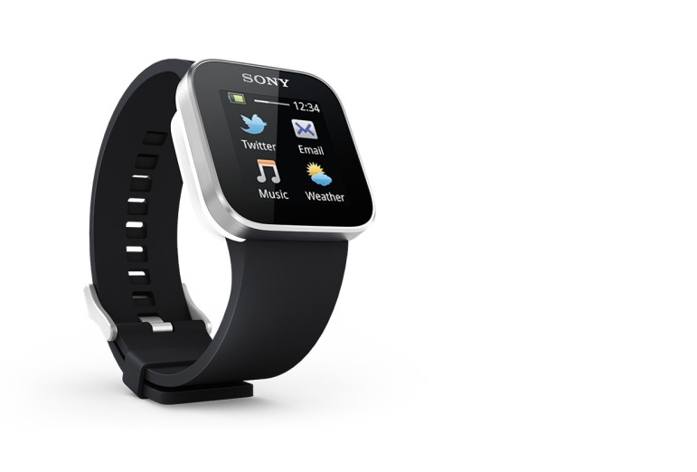
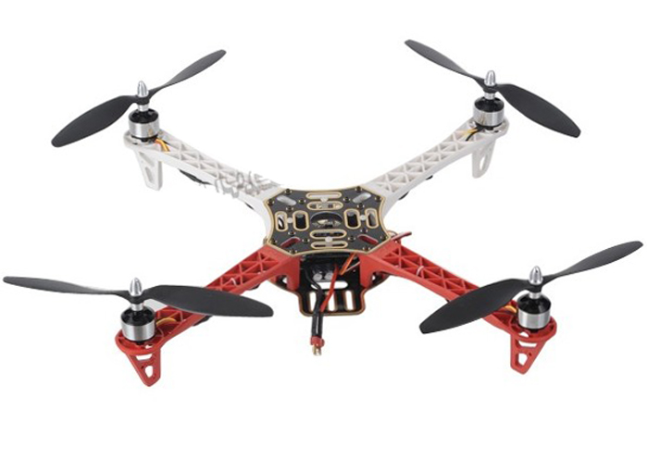
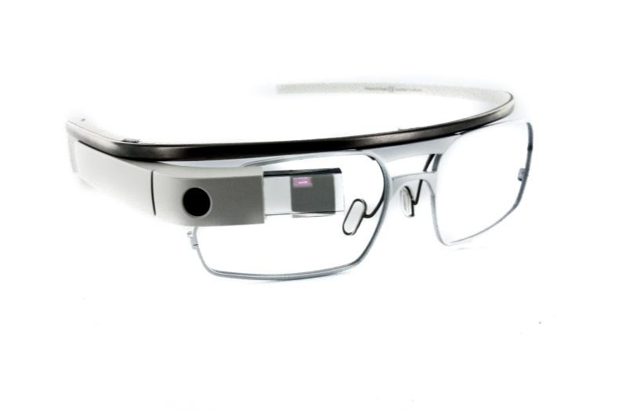
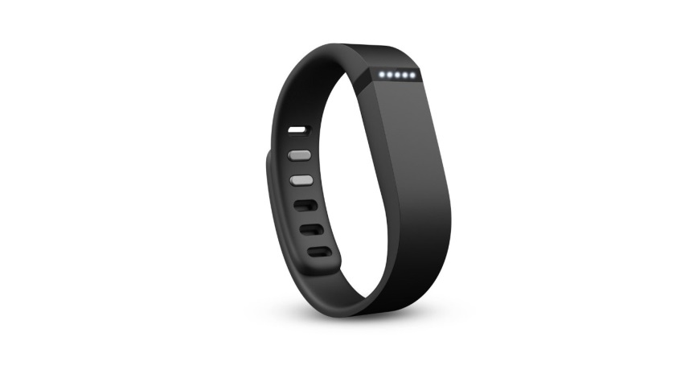
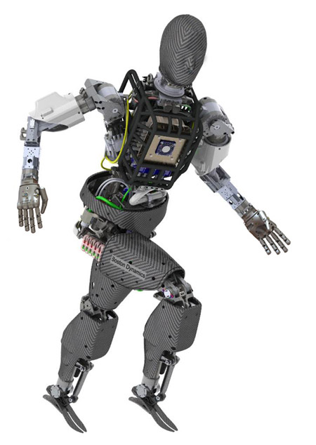
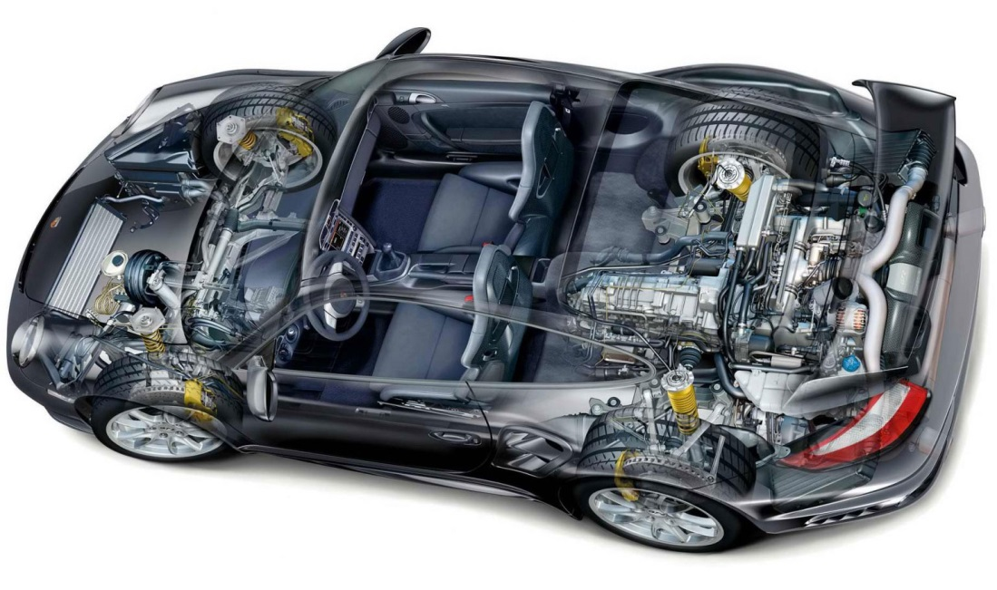
Embedded Systems

Slide 3
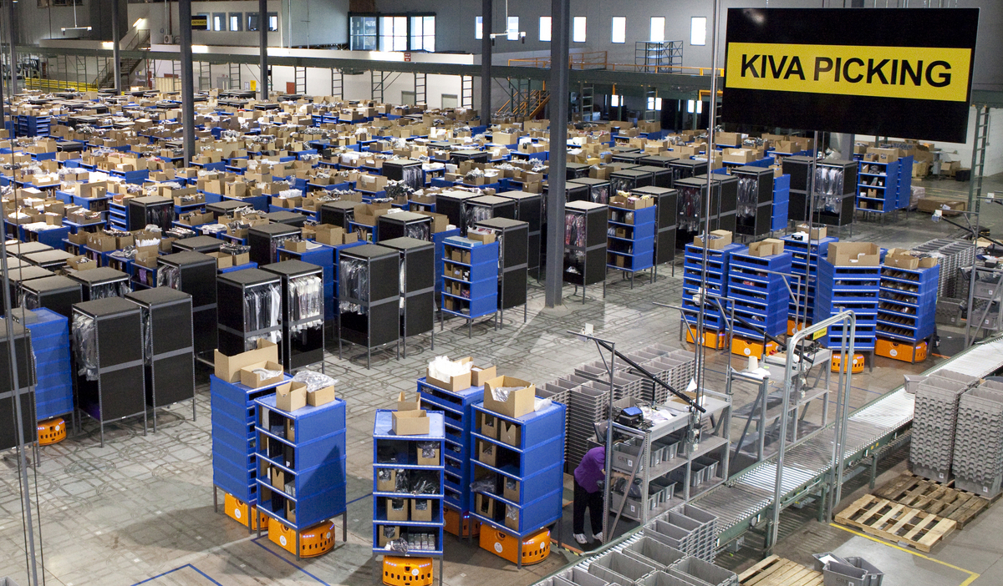
Amazon Warehouse
Kiva Robot

Slide 4
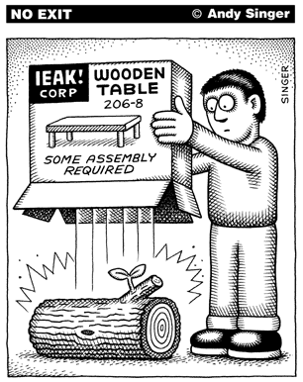
Assembly Programming
Embedded Systems
Performance, performance, performance!
Cost, cost cost!
http://www.andysinger.com/

Slide 5
Why should we learn Assembly?
Assembly isn’t “just another language”.
Help you understand how does the processor work
Assembly program runs faster than high-level language.
Performance critical codes may need to be written in assembly.
Use the profiling tools to find the performance bottle and rewrite that code section in assembly
Latency-sensitive applications, such as aircraft controller
Standard C compilers do not use some operations available on ARM processors, such ROR (Rotate Right) and RRX (Rotate Right Extended).
Hardware/processor specific code,
Processor booting code
Device drivers
Compiler, assembler, linker
A test-and-set atomic assembly instruction can be used to implement locks and semaphores.
Cost-sensitive applications
Embedded devices, where the size of code is limited, wash machine controller, automobile controllers
Better understand high-level programming languages

Slide 6
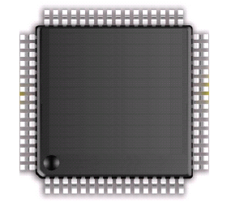
Why ARM processor
ARM: Acron RISC Machine
In 2010 alone, 6.1 billion ARM-based processor, representing 95% of smartphones, 35% of digital televisions and set-top boxes and 10% of mobile computers
As of 2019, 150 billion ARM processors have been produced
ADC
USB 2.0
DAC
Touch sensing
USART,SPI, I²C
Advanced timers
LCD Driver
Motor control

Slide 7
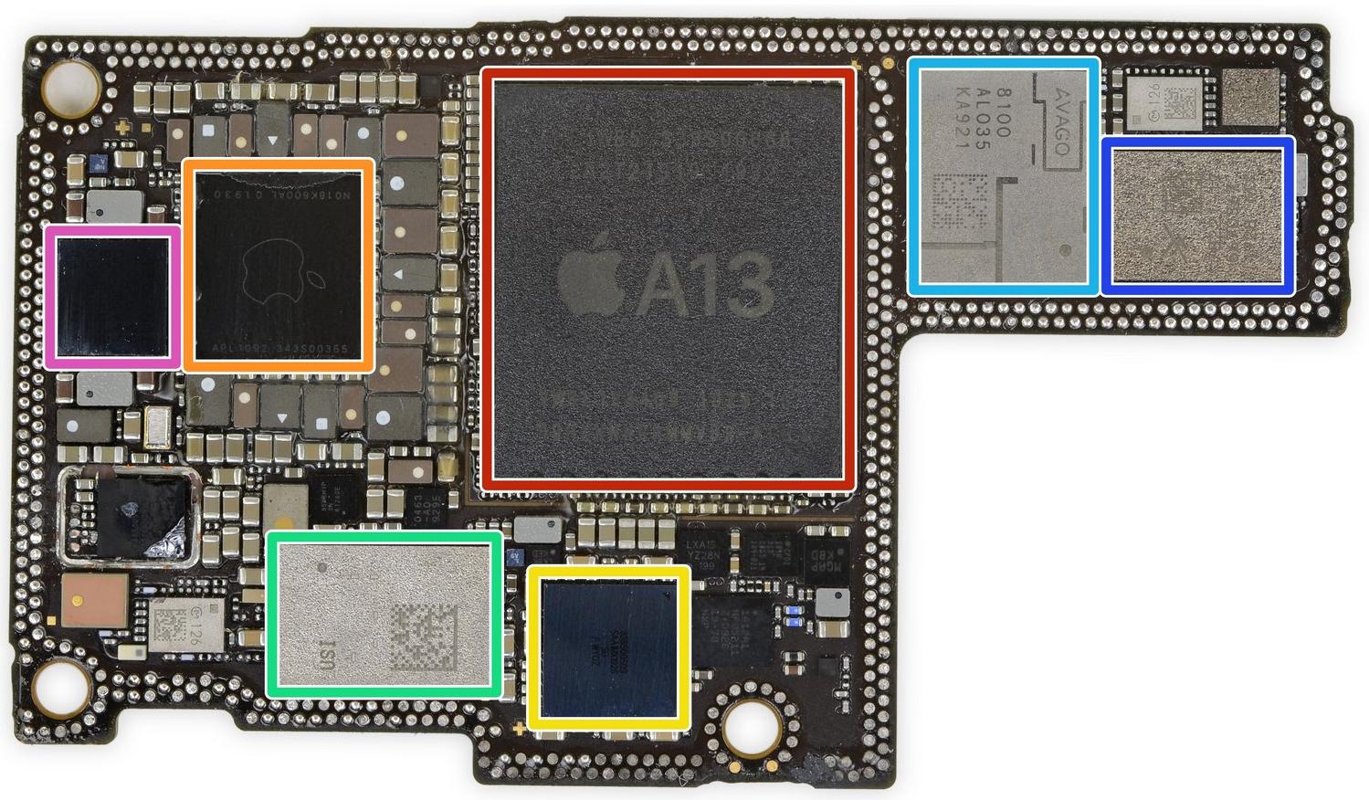
iPhone 11
A13 Bionic:
64-bit system on chip (SoC)
6 ARMv8.3-A cores
Introduced on Sept. 10, 2019
ifixit.com

Slide 8
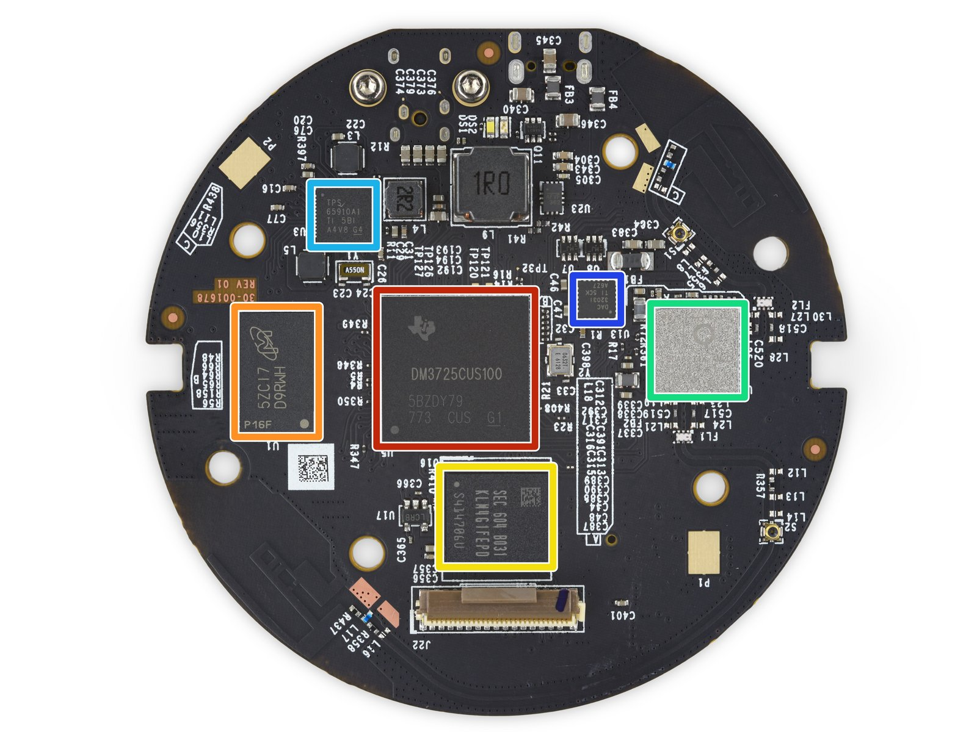
Amazon Echo (Alexa)
Texas Instruments DM3725 Digital Media Processor
ARM Cortex-A8

Slide 9
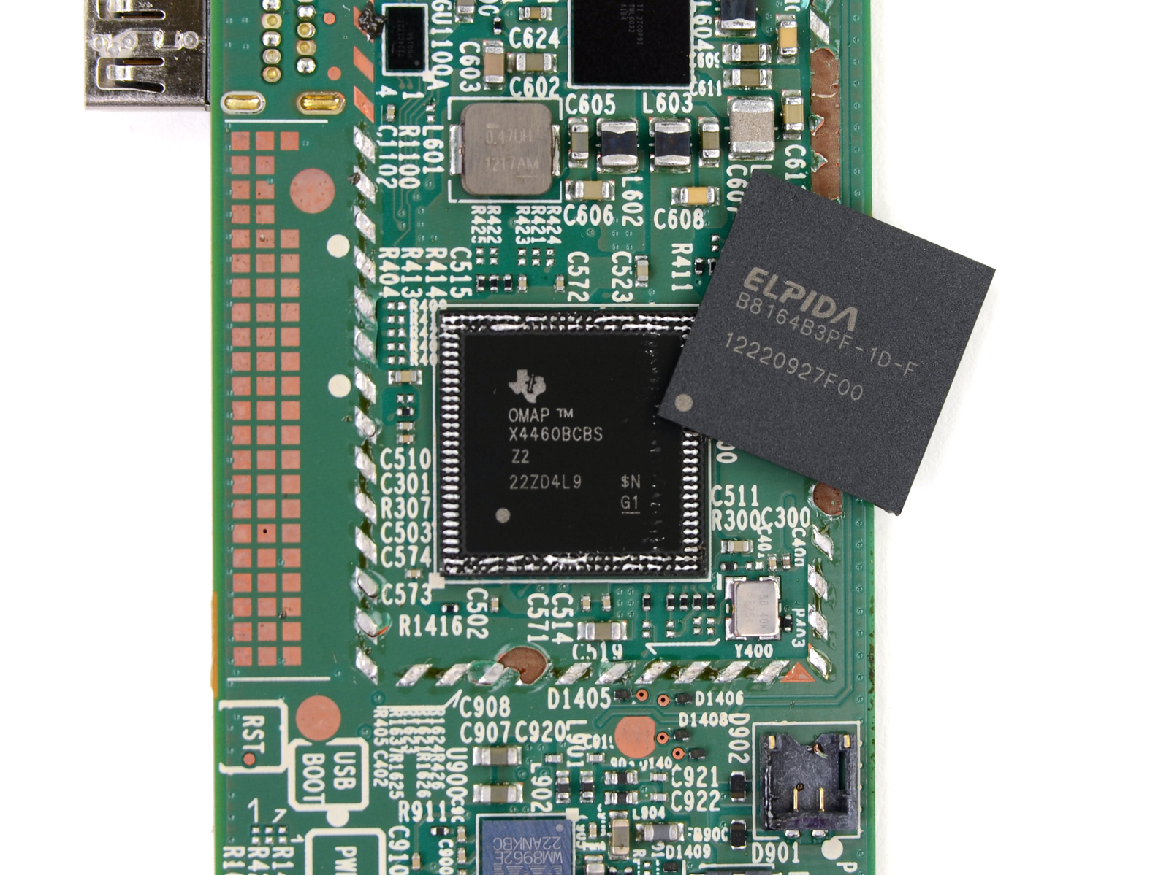
Kindle HD Fire
Texas Instruments OMAP 4460 dual-core processor
http://www.ifixit.com

Slide 10
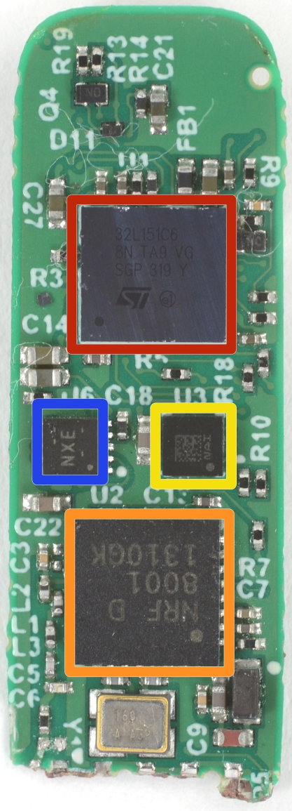

Fitbit Flex Teardown
STMicroelectronics 32L151C6 Ultra Low Power ARM Cortex M3 Microcontroller
Nordic Semiconductor nRF8001 Bluetooth Low Energy Connectivity IC
www.ifixit.com

Slide 11

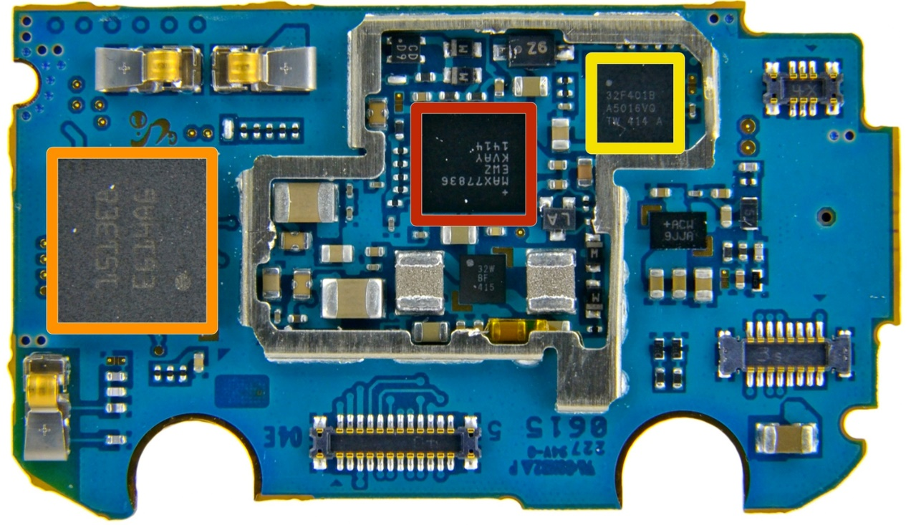
Samsung Galaxy Gear
STMicroelectronics STM32F401B ARM-Cortex M4 MCU with 128KB Flash
source: ifixit.com

Slide 12
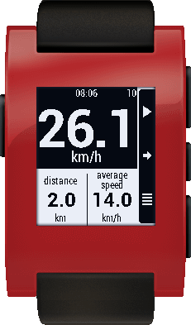
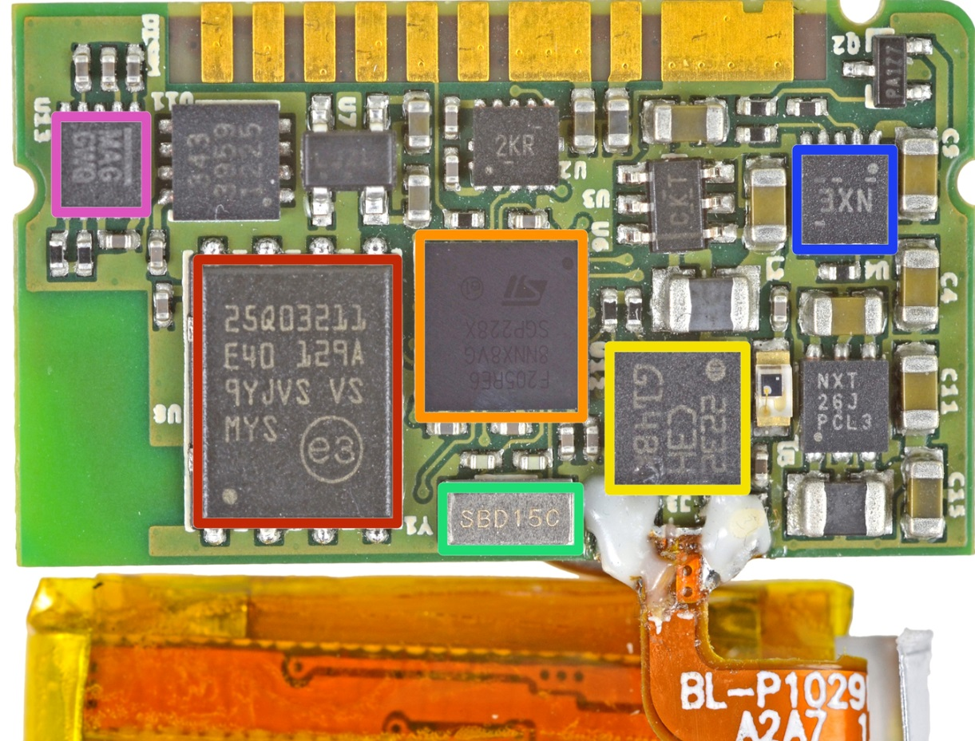
Pebble Smartwatch
source: ifixit.com
STMicroelectronics STM32F205RE ARM Cortex-M3 MCU, with a maximum speed of 120 MHz

Slide 13
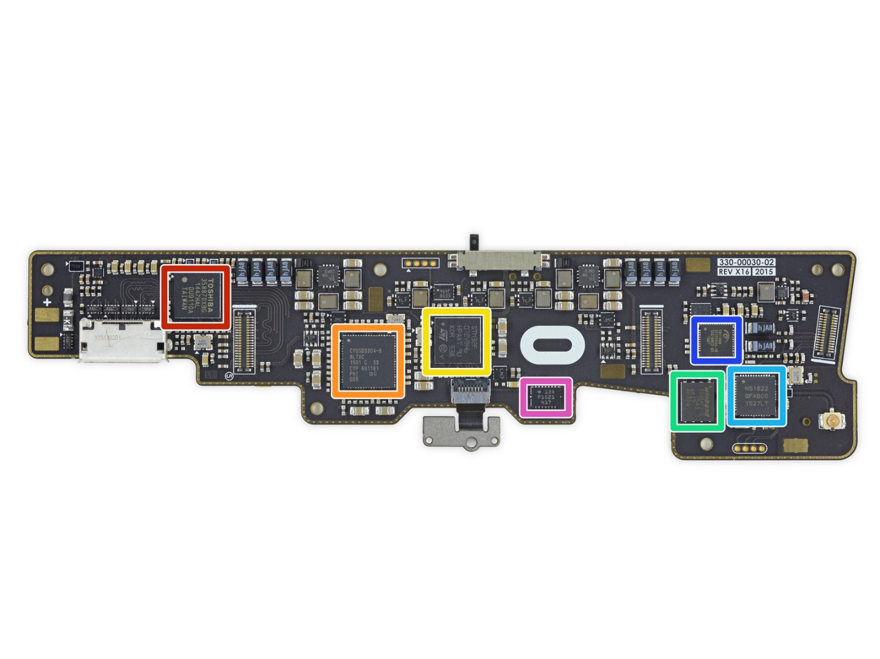

Oculus VR
Facebook’s $2 Billion Acquisition Of Oculus in 2014
ST Microelectronics STM32F072VB ARM Cortex-M0 32-bit RISC Core Microcontroller
source: ifixit.com

Slide 14
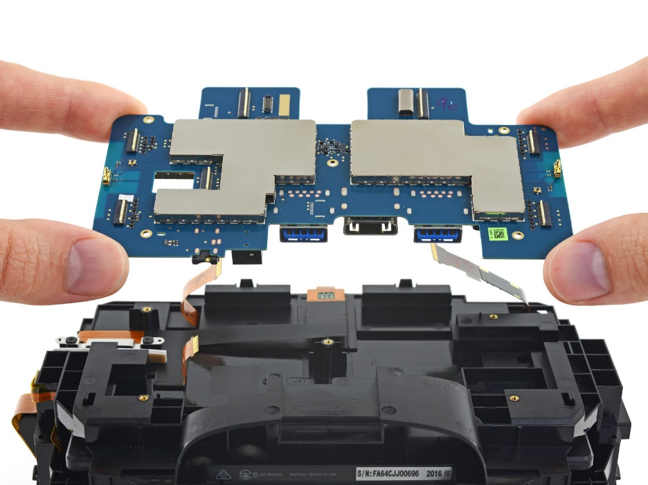
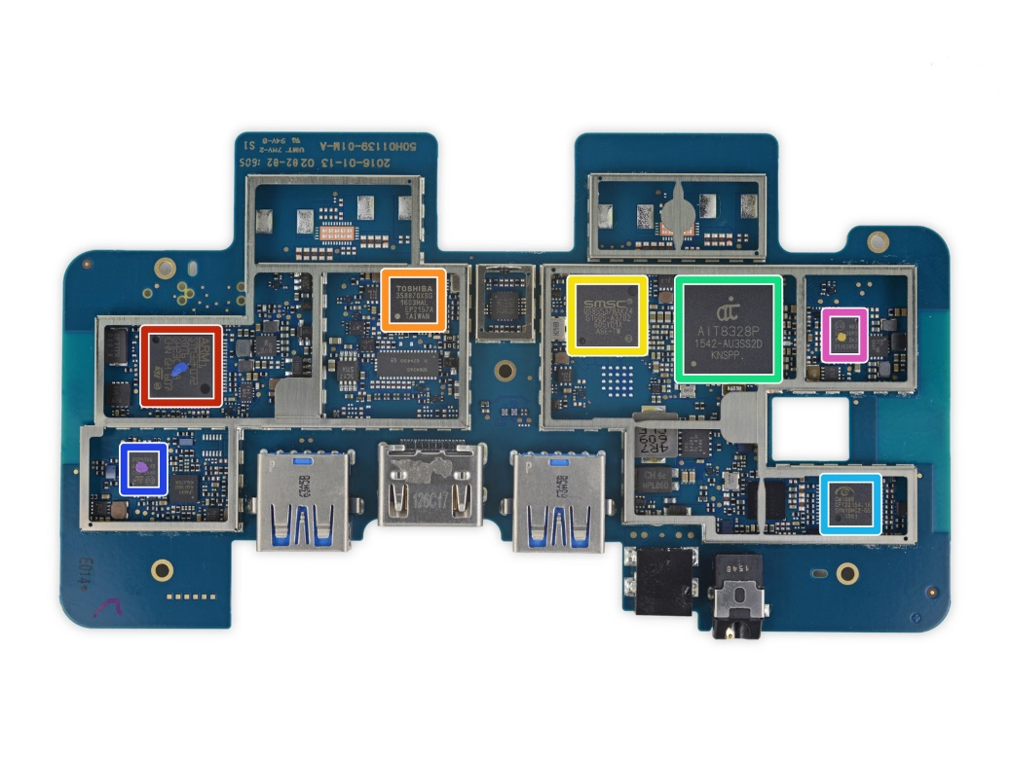
HTC Vive
STMicroelectronics 32F072R8 ARM Cortex-M0 Microcontroller
source: ifixit.com

Slide 15
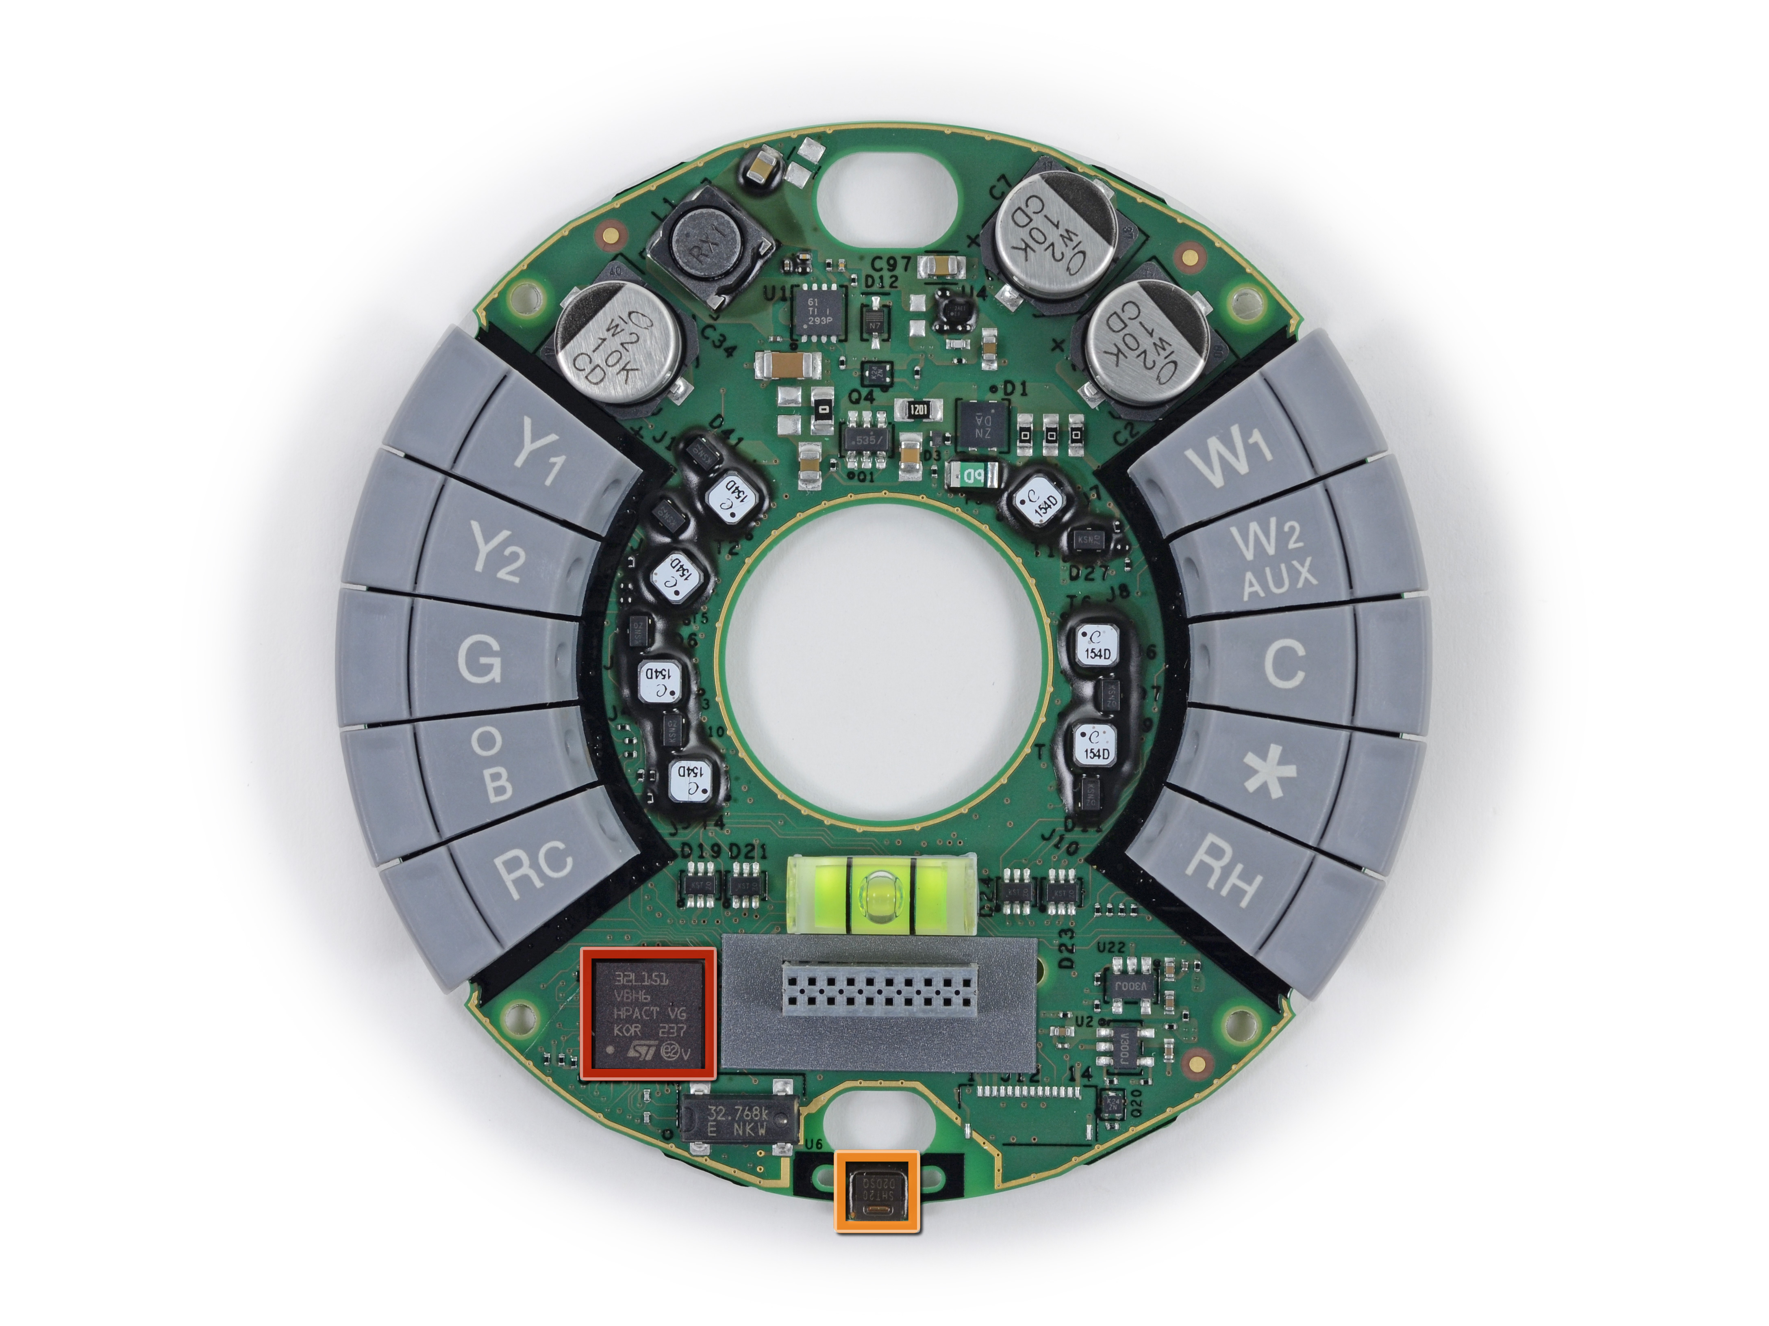
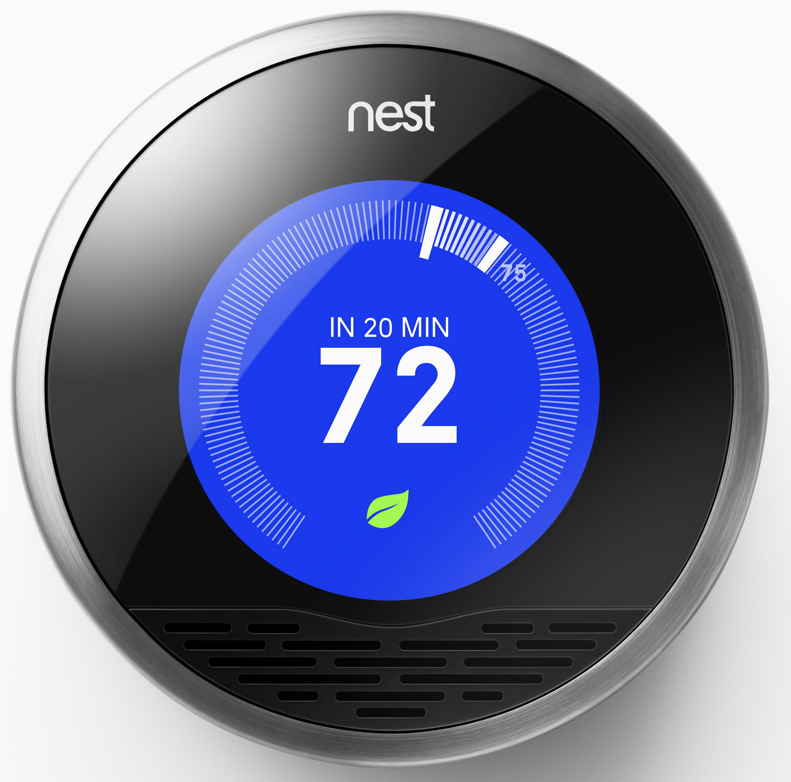
Nest Learning Thermostat
source: ifixit.com
ST Microelectronics STM32L151VB ultra-low-power 32 MHz ARM Cortex-M3 MCU

Slide 16
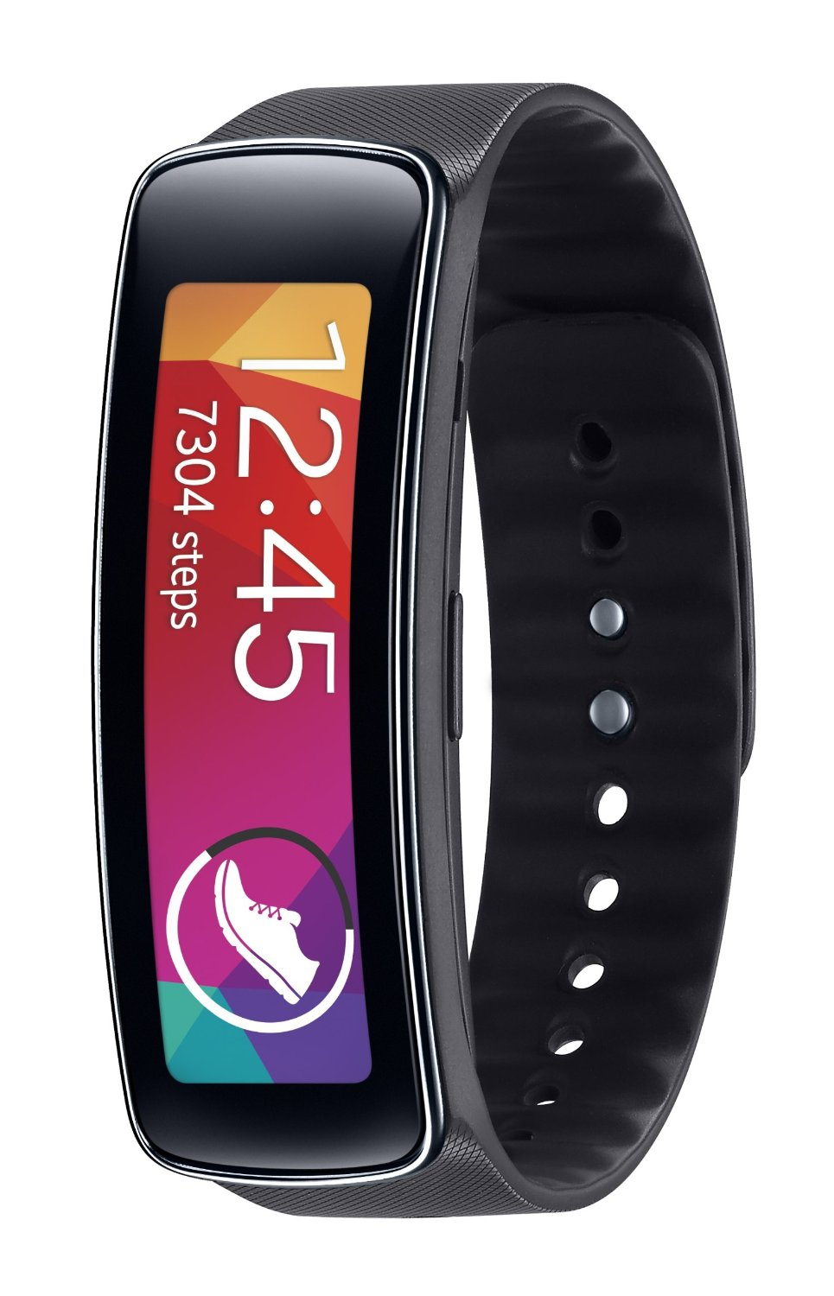
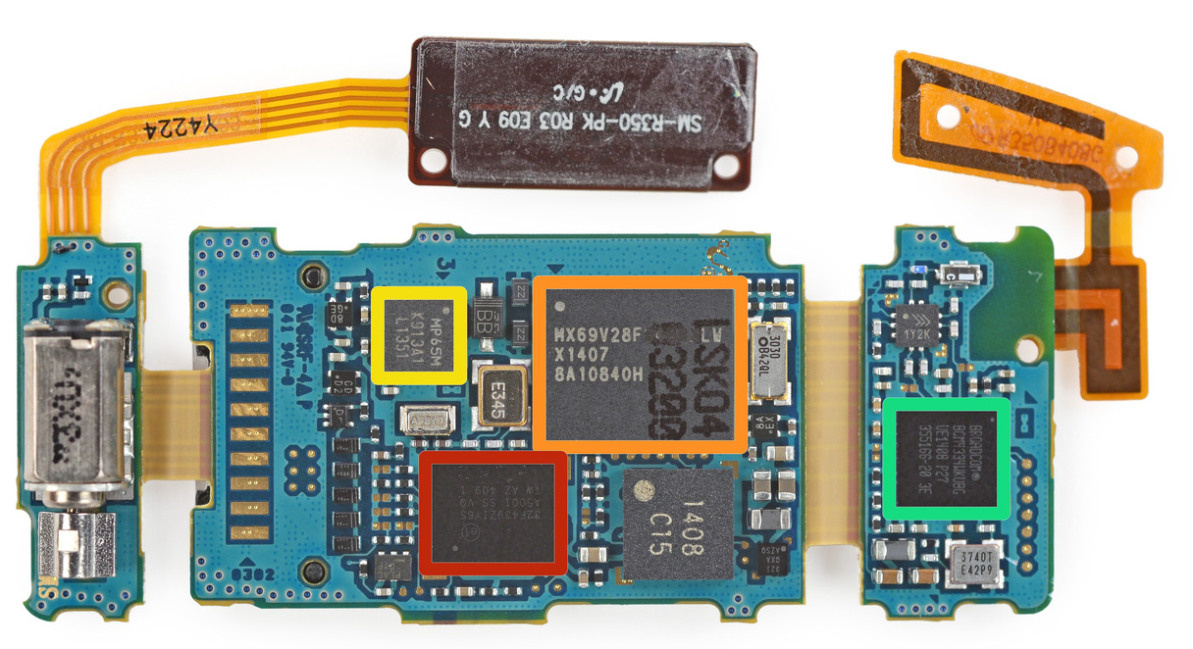
Samsung Gear Fit Fitness Tracker
source: ifixit.com
STMicroelectronics STM32F439ZI 180 MHz, 32 bit ARM Cortex-M4 CPU

Slide 17
Memory
Data
Address
8 bits
32 bits
Memory is arranged as a series of “locations”
Each location has a unique “address”
Each location holds a byte (byte-addressable)
e.g. the memory location at address 0x080001B0 contains the byte value 0x70, i.e., 112
The number of locations in memory is limited
e.g. 4 GB of RAM
1 Gigabyte (GB) = 2³⁰ bytes
2³² locations ➔ 4,294,967,296 locations!
Values stored at each location can represent either program data or program instructions
e.g. the value 0x70 might be the code used to tell the processor to add two values together
0xFFFFFFFF
70
BC
18
01
A0
0x080001B0
0x080001AF
0x080001AE
0x080001AD
0x080001AC
0x00000000
Memory

Slide 18
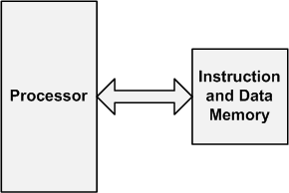
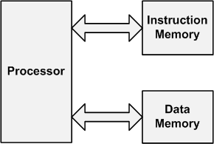
Computer Architecture
Von-Neumann
Harvard
Instructions and data are stored in the same memory.
Data and instructions are stored into separate memories.

Slide 19
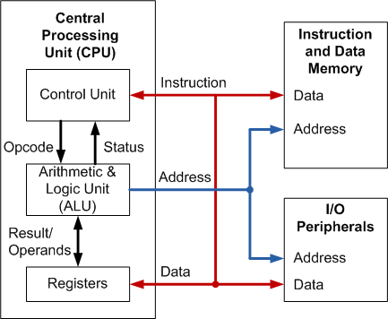
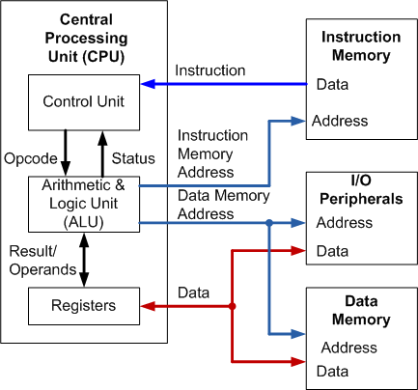
Computer Architecture
Von-Neumann
Harvard
Instructions and data are stored in the same memory.
Data and instructions are stored into separate memories.

Slide 20
ARM Cortex-M Series Family
Von-Neumann
Harvard
Instructions and data are stored in the same memory.
Data and instructions are stored into separate memories.
ARM
Cortex-M0
ARM
Cortex-M0+
ARM
Cortex-M3
ARM
Cortex-M4
ARMv6-M
ARMv6-M
ARMv7-M
ARMv7E-M
ARM
Cortex-M1
ARM
Cortex-M23
ARM
Cortex-M7
ARM
Cortex-M33
ARMv6-M
ARMv8-M
ARMv7E-M
ARMv8-M

Slide 21
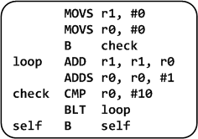
Levels of Program Code
C Program
Assembly Program
Machine Program
0010000100000000
0010000000000000
1110000000000001
0100010000000001
0001110001000000
0010100000001010
1101110011111011
1011111100000000
1110011111111110
int main(void){
int i;
int total = 0;
for (i = 0; i < 10; i++) {
total += i;
}
while(1); // Dead loop
}
Compile
Assemble
High-level language
Level of abstraction closer to problem domain
Provides for productivity and portability
Assembly language
Textual representation of instructions
Human-readable format instructions
Hardware representation
Binary digits (bits)
Encoded instructions and data
Computer-readable format instructions

Slide 22
See a Program Runs
C Code
Assembly Code
int main(void){
int a = 0;
int b = 1;
int c;
c = a + b;
return 0;
}
MOVS r1, #0x00 ; int a = 0
MOVS r2, #0x01 ; int b = 1
ADDS r3, r1, r2 ; c = a + b
MOVS r0, 0x00 ; set return value
BX lr ; return
compiler
assembler
Machine Code
0010000100000000
0010001000000001
0001100010001011
0010000000000000
0100011101110000
2100
2201
188B
2000
4770
; MOVS r1, #0x00
; MOVS r2, #0x01
; ADDS r3, r1, r2
; MOVS r0, #0x00
; BX lr
In Binary
In Hex

Slide 23
Processor Registers
Fastest way to read and write
Registers are within the processor chip
A register stores 32-bit value
ARM Cortex-M has
R0-R12: 13 general-purpose registers
R13: Stack pointer (Shadow of MSP or PSP)
R14: Link register (LR)
R15: Program counter (PC)
Special registers (xPSR, BASEPRI, PRIMASK, etc)

Slide 24
Program Execution
Program Counter (PC) is a register that holds the memory address of the next instruction to be fetched from the memory.
Memory Address
1. Fetch instruction at PC address
4770 2000
188B
2201
2100
0x080001B4
0x080001B2
0x080001B0
0x080001AE
0x080001AC
PC
3. Execute the instruction
2. Decode the instruction
PC = 0x080001B0
Instruction = 188B or
2000188B or 8B180020

Slide 25
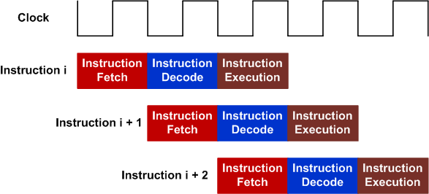
Three-state pipeline: Fetch, Decode, Execution
Pipelining allows hardware resources to be fully utilized
One 32-bit instruction or two 16-bit instructions can be fetched.
Pipeline of 32-bit instructions

Slide 26
Three-state pipeline: Fetch, Decode, Execution
Pipelining allows hardware resources to be fully utilized
One 32-bit instruction or two 16-bit instructions can be fetched.
Pipeline of 16-bit instructions

Slide 27
Machine codes are stored in memory
Data
Address
r15
pc
0xFFFFFFFF
r14
lr
r13
sp
r12
r11
r10
r9
4770 2000
188B
2201
2100
0x080001B4
0x080001B2
0x080001B0
0x080001AE
0x080001AC
r8
ALU
r7
r6
r5
r4
r3
r2
r1
r0
0x00000000
Registers
CPU
Memory

Slide 28
Fetch Instruction: pc = 0x08001AC Decode Instruction: 2100 = MOVS r1, #0x00
Data
Address
r15
0x080001AC
pc
0xFFFFFFFF
r14
lr
r13
sp
r12
r11
r10
r9
4770 2000
188B
2201
2100
0x080001B4
0x080001B2
0x080001B0
0x080001AE
0x080001AC
r8
ALU
r7
r6
r5
r4
r3
r2
r1
r0
0x00000000
Registers
CPU
Memory

Slide 29
Execute Instruction: MOVS r1, #0x00
Data
Address
r15
0x080001AC
pc
0xFFFFFFFF
r14
lr
r13
sp
r12
r11
r10
r9
4770 2000
188B
2201
2100
0x080001B4
0x080001B2
0x080001B0
0x080001AE
0x080001AC
r8
ALU
r7
r6
r5
r4
r3
r2
r1
0x00000000
r0
0x00000000
Registers
CPU
Memory

Slide 30
Fetch Next Instruction: pc = pc + 2
Data
Address
r15
0x080001AE
pc
0xFFFFFFFF
r14
lr
Thumb-2 consists of a mix of 16- & 32-bit instructions
In reality, we always fetch 4 bytes from the instruction memory (either one 32-bit instruction or two 16-bit instructions)
To simplify the demo, we assume we only fetch 2 bytes from the instruction memory in this example.
r13
sp
r12
r11
r10
r9
4770 2000
188B
2201
2100
0x080001B4
0x080001B2
0x080001B0
0x080001AE
0x080001AC
r8
ALU
r7
r6
r5
r4
r3
r2
r1
0x00000000
r0
0x00000000
Registers
CPU
Memory

Slide 31
Fetch Next Instruction: pc = pc + 2 Decode & Execute: 2201 = MOVS r2, #0x01
Data
Address
r15
0x080001AE
pc
0xFFFFFFFF
r14
lr
r13
sp
r12
r11
r10
r9
4770 2000
188B
2201
2100
0x080001B4
0x080001B2
0x080001B0
0x080001AE
0x080001AC
r8
ALU
r7
r6
r5
r4
r3
r2
0x00000001
r1
0x00000000
r0
0x00000000
Registers
CPU
Memory

Slide 32
Fetch Next Instruction: pc = pc + 2 Decode & Execute: 188B = ADDS r3, r1, r2
Data
Address
r15
0x080001B0
pc
0xFFFFFFFF
r14
lr
r13
sp
r12
r11
r10
r9
4770 2000
188B
2201
2100
0x080001B4
0x080001B2
0x080001B0
0x080001AE
0x080001AC
r8
ALU
r7
r6
r5
r4
r3
0x00000001
r2
0x00000001
r1
0x00000000
r0
0x00000000
Registers
CPU
Memory

Slide 33
Fetch Next Instruction: pc = pc + 2 Decode & Execute: 2000 = MOVS r0, #0x00
Data
Address
r15
0x080001B2
pc
0xFFFFFFFF
r14
lr
r13
sp
r12
r11
r10
r9
4770 2000
188B
2201
2100
0x080001B4
0x080001B2
0x080001B0
0x080001AE
0x080001AC
r8
ALU
r7
r6
r5
r4
r3
r2
0x00000001
r1
0x00000000
r0
0x00000000
0x00000000
Registers
CPU
Memory

Slide 34
Fetch Next Instruction: pc = pc + 2 Decode & Decode: 4770 = BX lr
Data
Address
r15
0x080001B4
pc
0xFFFFFFFF
r14
lr
r13
sp
r12
r11
r10
r9
4770 2000
188B
2201
2100
0x080001B4
0x080001B2
0x080001B0
0x080001AE
0x080001AC
r8
ALU
r7
r6
r5
r4
r3
r2
0x00000001
r1
0x00000000
r0
0x00000000
0x00000000
Registers
CPU
Memory

Slide 35
Realities
In the previous example,
PC is incremented by 2
Well, I lied!

Slide 36
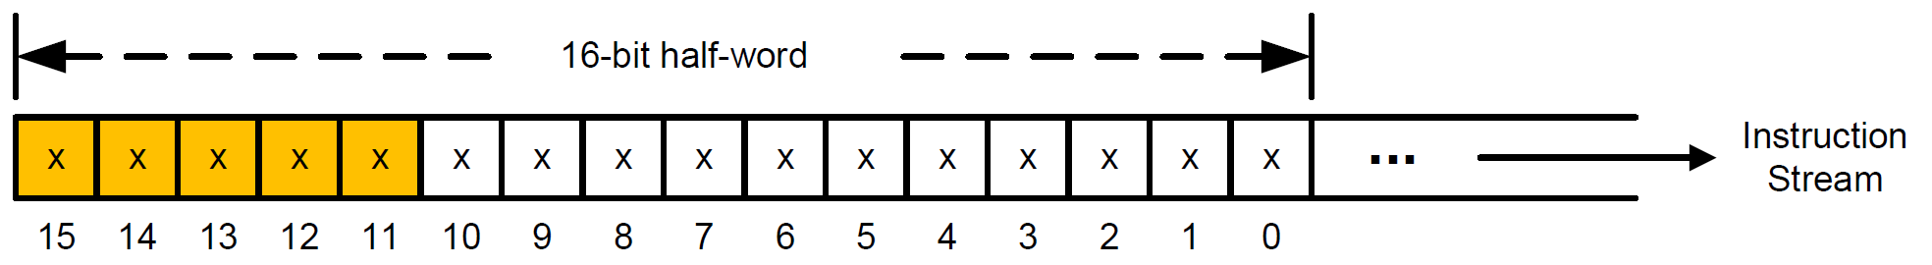
Realities
PC is always incremented by 4.
Each time, 4 bytes are fetched from the instruction memory
It is either two 16-bit instructions or one 32-bit instruction
If bit [15-11] = 11101, 11110, or 11111, then, it is the first half-word of a 32-bit instruction.
Otherwise, it is a 16-bit instruction.

Slide 37
Example: Calculate the Sum of an Array
int a[10] = {1, 2, 3, 4, 5, 6, 7, 8, 9, 10};
int total;
int main(void){
int i;
total = 0;
for (i = 0; i < 10; i++) {
total += a[i];
}
while(1);
}

Slide 38
Example: Calculate the Sum of an Array
Instruction Memory (Flash)
Data
Memory (RAM)
int main(void){
int i;
total = 0;
for (i = 0; i < 10; i++) {
total += a[i];
}
while(1);
}
int a[10] = {1, 2, 3, 4, 5, 6, 7, 8, 9, 10};
int total;
CPU
I/O Devices
Starting memory address
0x08000000
Starting memory address
0x20000000
Notes:
#define __I volatile const /*!< defines 'read only' permissions */
#define __O volatile /*!< defines 'write only' permissions */
#define __IO volatile /*!< defines 'read / write' permissions */

Slide 39
Example: Calculate the Sum of an Array
0010 0001 0000 0000
0100 1010 0000 1000
0110 0000 0001 0001
0010 0000 0000 0000
1110 0000 0000 1000
0100 1001 0000 0111
1111 1000 0101 0001 0001 0000 0010 0000
0100 1010 0000 0100
0110 1000 0001 0010
0100 0100 0001 0001
0100 1010 0000 0011
0110 0000 0001 0001
0001 1100 0100 0000
0010 1000 0000 1010
1101 1011 1111 0100
1011 1111 0000 0000
1110 0111 1111 1110
Instruction Memory (Flash)
MOVS r1, #0x00
LDR r2, = total_addr
STR r1, [r2, #0x00]
MOVS r0, #0x00
B Check
Loop: LDR r1, = a_addr
LDR r1, [r1, r0, LSL #2]
LDR r2, = total_addr
LDR r2, [r2, #0x00]
ADD r1, r1, r2
LDR r2, = total_addr
STR r1, [r2,#0x00]
ADDS r0, r0, #1
Check: CMP r0, #0x0A
BLT Loop
NOP
Self: B Self
int main(void){
int i;
total = 0;
for (i = 0; i < 10; i++) {
total += a[i];
}
while(1);
}
Starting memory address
0x08000000
Notes:
#define __I volatile const /*!< defines 'read only' permissions */
#define __O volatile /*!< defines 'write only' permissions */
#define __IO volatile /*!< defines 'read / write' permissions */

Slide 40
Example: Calculate the Sum of an Array
0x20000054
0x20000050
0x2000004C
0x20000048
0x20000044
0x20000040
0x2000003C 0x20000038
0x20000034
0x20000030
0x2000002C
0x20000028
0x20000024
0x20000020
0x2000001C
0x20000018
0x20000014
0x20000010
0x2000000C
0x20000008
0x20000004
0x20000000
0x00000000
0x00000000
0x00000000
0x00000000
0x00000000
0x00000000
0x00000000 0x00000000
0x00000000
0x00000000
0x00000000
0x00000000
0x0000000A
0x00000009
0x00000008
0x00000007
0x00000006
0x00000005
0x00000004
0x00000003
0x00000002
0x00000001
Data
Memory (RAM)
int a[10] = {1, 2, 3, 4, 5, 6, 7, 8, 9, 10};
int total;
total= 0x00000000
a[9] = 0x0000000A
a[8] = 0x00000009
a[7] = 0x00000008
a[6] = 0x00000007
a[5] = 0x00000006
a[4] = 0x00000005
a[3] = 0x00000004
a[2] = 0x00000003
a[1] = 0x00000002
a[0] = 0x00000001
Assume the starting memory address of the data memory is 0x20000000
Memory
address
in bytes
Memory
content
Notes:
#define __I volatile const /*!< defines 'read only' permissions */
#define __O volatile /*!< defines 'write only' permissions */
#define __IO volatile /*!< defines 'read / write' permissions */

Slide 41
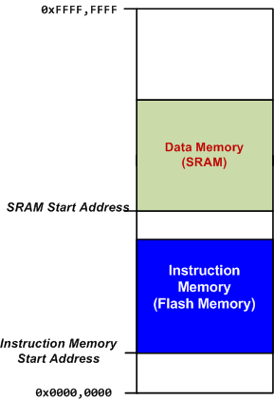
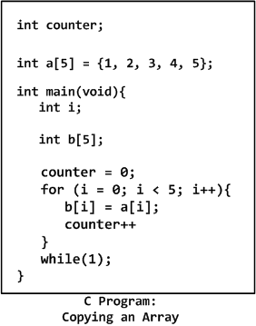

Loading Code and Data into Memory

Slide 42
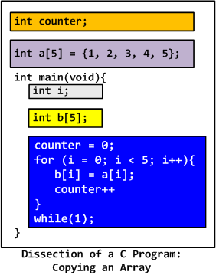
Loading Code and Data into Memory

Slide 43
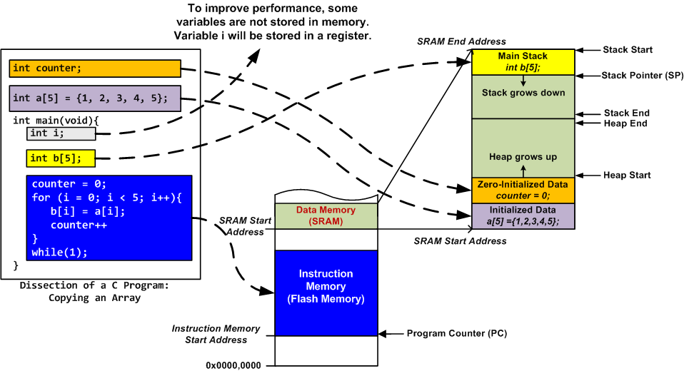
Loading Code and Data into Memory
Stack is mandatory
Heap is used only if dynamic allocation (e.g. malloc, calloc) is used.

Slide 44
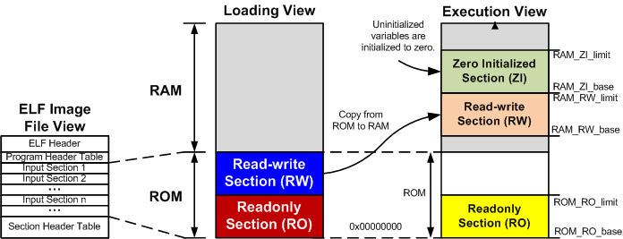
View of a Binary Program

Slide 45
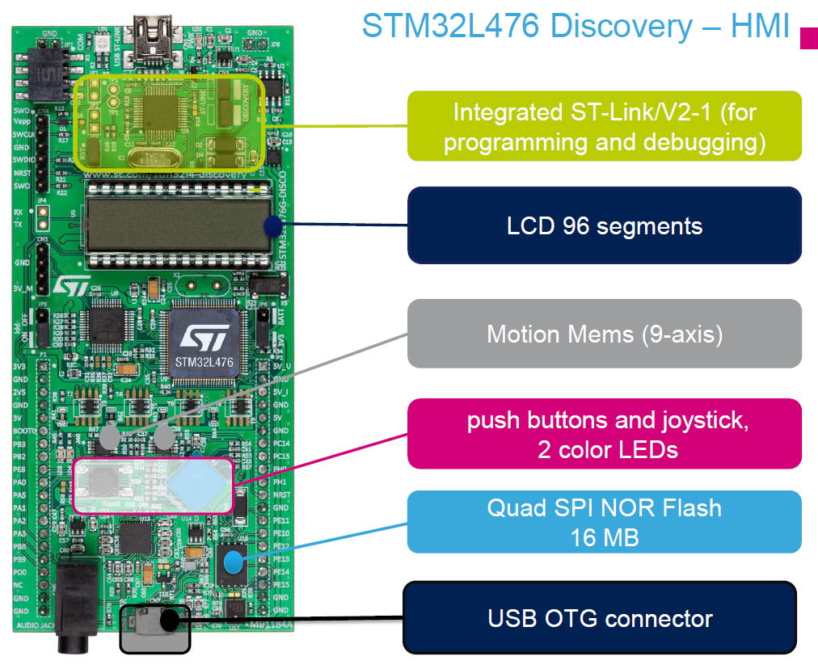
from st.com

Slide 46
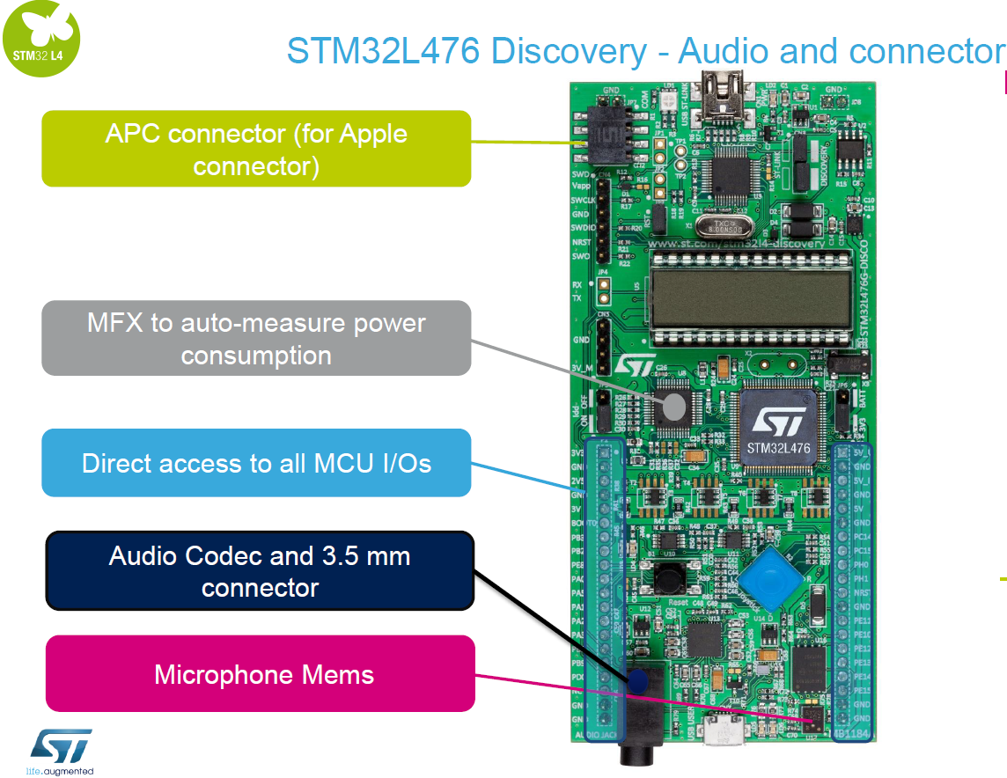
from st.com

Slide 47
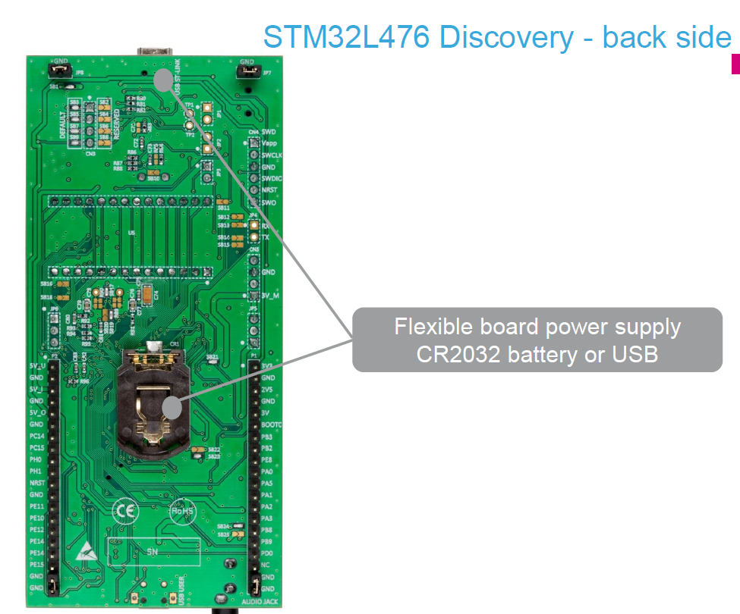
from st.com

Slide 48
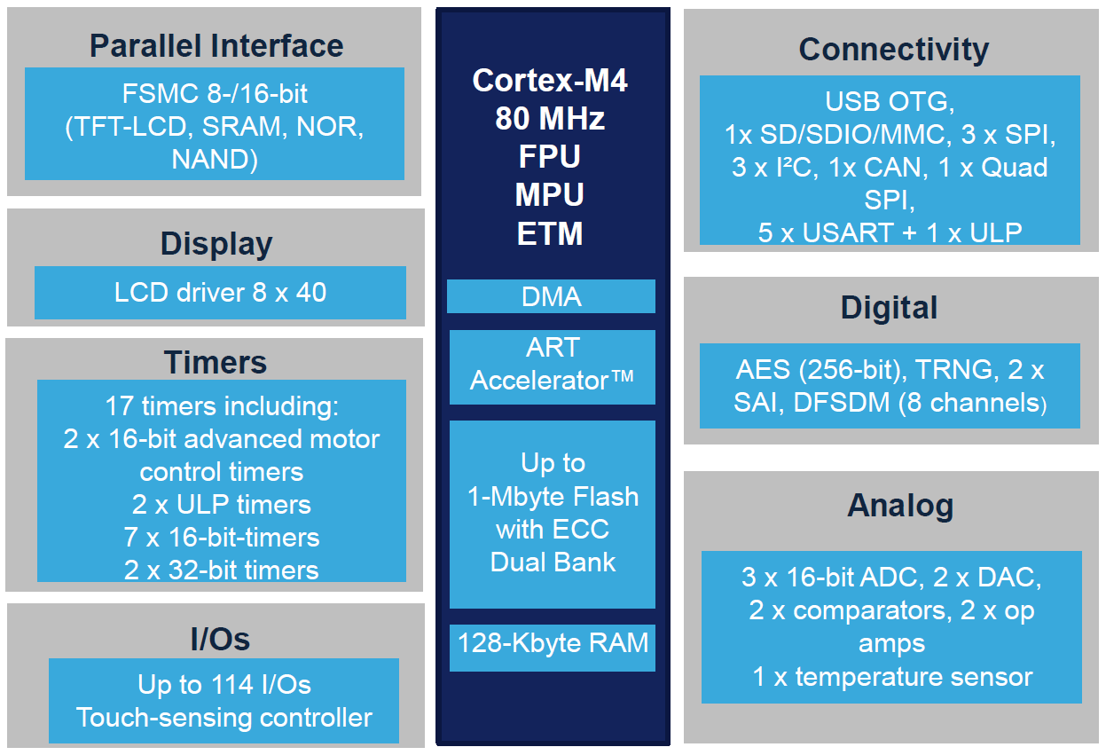
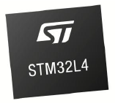
STM32L4
from st.com

Slide 49
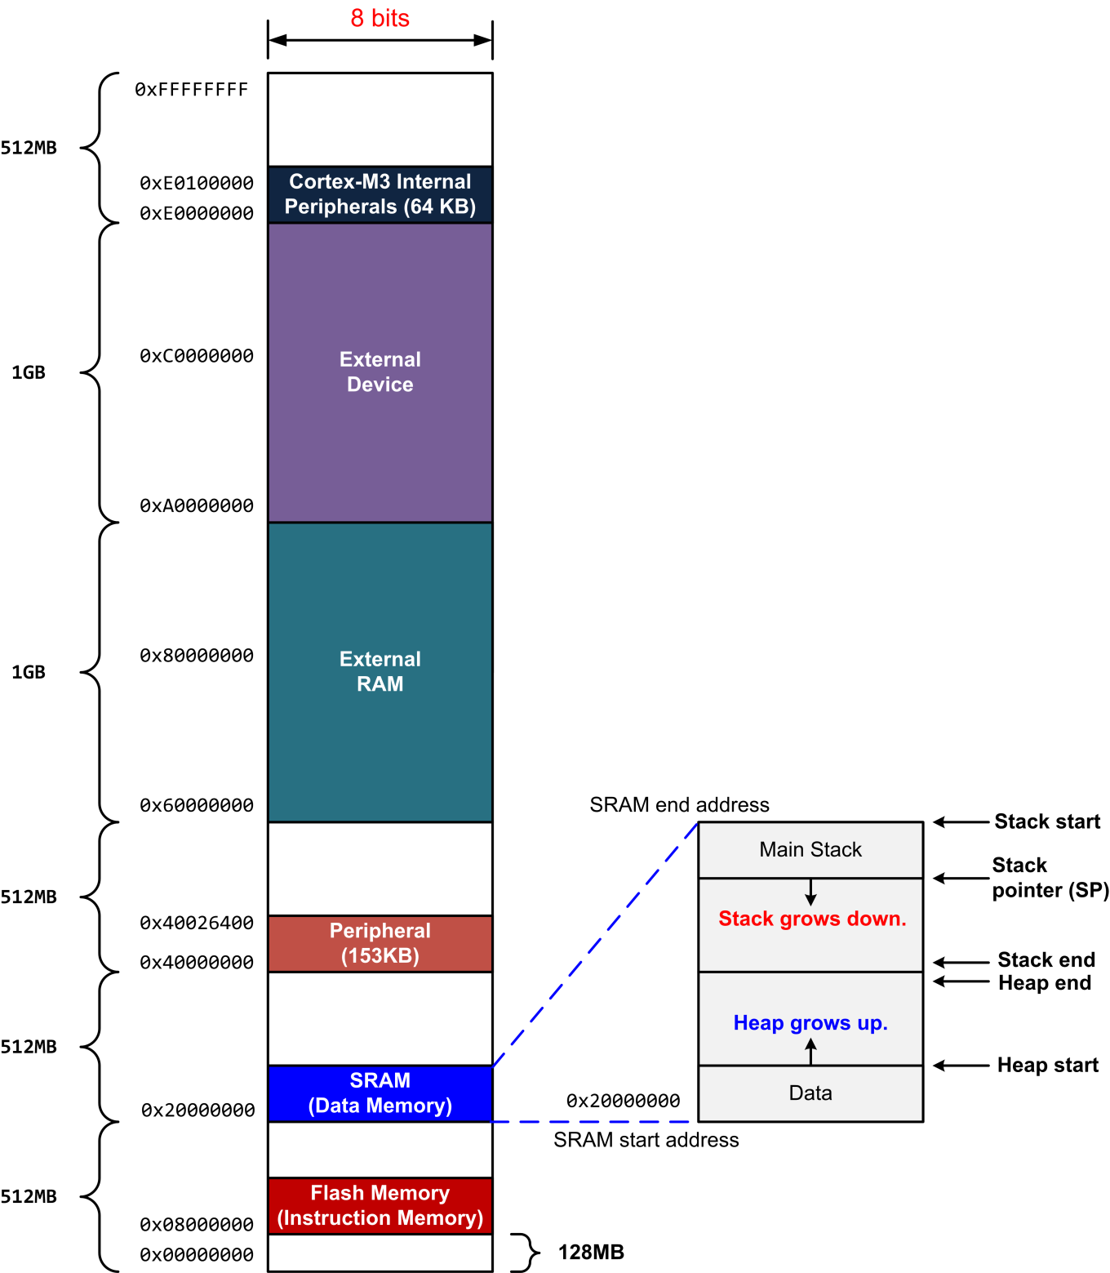
Memory Map

